Slide 1

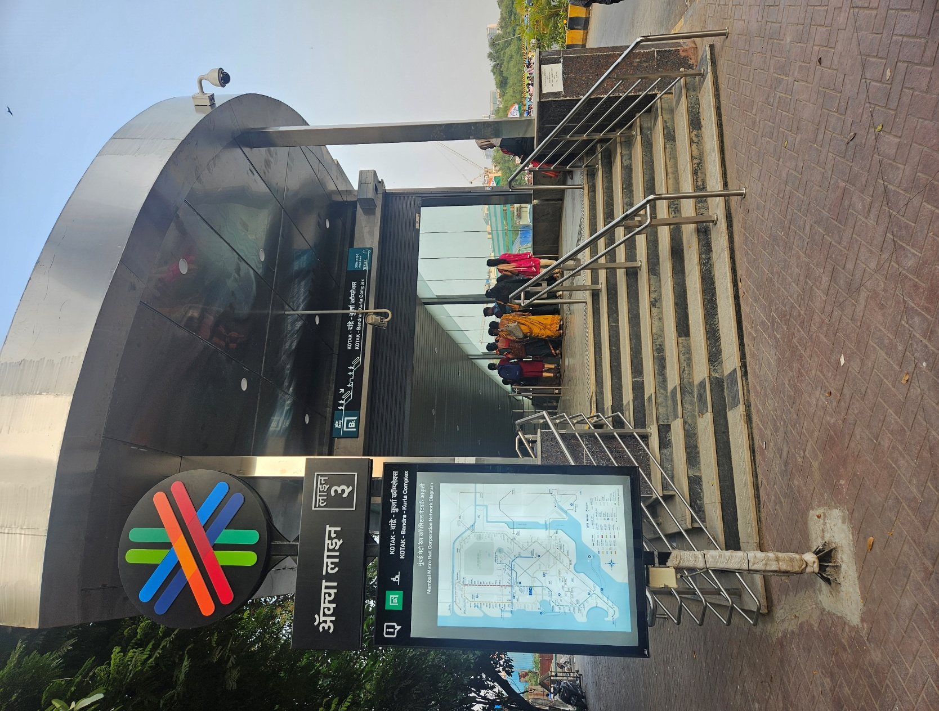
Group 1
Gantt Chart for Aqua line
Presented By
Adnan Shaikh M2024007 Fatima Momin M2024036
Jasmin Maniyar M2024044
Meeran Qazi M2024054
Midhat Sayed M2024056
Presented to :- Prof. Nagendra Aswatha

Slide 2
Gantt Chart Overview
Budget Allocation
Feedback & Risks
Gantt Chart 1 & 2
Problems & Solutions

Slide 3
Gantt Chart Overview
Visual project management tool
Structure: Comprises a horizontal bar chart with tasks
Purpose: Helps in planning, scheduling, and tracking project timelines
Tasks
Timelines
Progress

Slide 4



Gantt Chart Overview
Key elements of Gantt Charts are
Tasks
Dependencies
Progress tracking
Advantages
Clear visualization
Flexible
Better Communication
Tools:

Slide 5
Gantt Chart 1
Planning & Feasibility study
Feasibility study
Detailed Planning
Government Approval
Pre Const &Land Acquisition
Land Acquisition
Site Preparation
Station Design
Construction
Foundation Work
Tunnelling
Station Construction
Alignment & Deployment
Track lying
System Installation
Testing & Commission
Trail Runs
System Testing
Final Testing
Project Completion

Slide 6
Gantt Chart 2
Present
Planning & Feasibility study
Feasibility study
Detailed Planning
Government Approval
Land Acquisition & Pre Const
Land Acquisition
Site Preparation
Station Design
Construction
Foundation Work
Tunnelling
Station Construction
Alignment & Deployment
Track lying
System Installation
Testing & Commission
Trail Runs
System Testing
Final Testing
Project Completion

Slide 7
Budget Allocation
Total Budget:- ₹37,530
Amount in Crores

Slide 8
Budget Allocation
Amount in Crores
Total Budget:- ₹37,530
Planning:- ₹3200
Government Approval:- ₹750
Land Acquisition & Pre Constructions:- ₹4550
Construction:- ₹ 24600
Land Acquisition:- ₹ 2200
Site Preparation:- ₹ 1650
Station Design:- ₹ 700
Foundation Work:- ₹ 1800
Tunnelling:- ₹ 9200
Station Construction:- ₹ 13,600

Slide 9
Budget Allocation
Amount in Crores
Total Budget:- ₹37,530
Track Lying & System Installation:- ₹ 1850
Testing & Commission:- ₹ 1080
Project Completion:- ₹ 1500
Track Lying :- ₹ 950
System Installation :- ₹ 900
Trail Runs:- ₹ 210
System Testing:- ₹ 350
Final Testing:- ₹ 520

Slide 10
Problems and Solutions
v
Problems
Solutions
1) Land Acquisition: 45.81 hectares total
Government Land: 41.087 hectares
Private Land: 4.72 hectares
Challenge: Resistance from people to move, making the process tougher
Fair Compensation and new house and place for affected people

Slide 11
Problems and Solutions
v
Problems
Solutions
2) Delay because of Covid 19
Construction stopped from March 2020-August 2020
September 2020 till December 2020 ¼ Worker started working
April 2021 work was fully started
Extra Laborers were hired
Support from Government Authorities

Slide 12
Problems and Solutions
v
Problems
Solutions
3) Tunneling issue
Underground tunneling was difficult due to high density and populated area
Causing damage to surrounding
Used NATM (New Australian tunneling method)

Slide 13
Problems and Solutions
v
Problems
Solutions
Most of the work done on non peak hour
Divert routes
4) Traffic Management
Significant increase in traffic due to metro work above and below

Slide 14
Risks
Power outages, signaling failures, or accidents during operations
Fires, toxic smoke, or explosions underground

Slide 15
Risks
Water ingress during construction or operation, particularly in flood-prone areas.
Ground settlement, tunnel collapse, or unexpected soil or rock conditions

Slide 16
Feedbacks
1) Overall satisfaction
2) Strengths
Average score: 4.16/5
98% of respondents were satisfied
Cleanliness: Stations and trains scored 4.3
Punctuality & Safety: Rated 4.0
Ticketing Systems: Scored 4.32
3) Staff & Communication
4) Challenges Identified
Parking facilities: Lowest score at 2.5
Restrooms: Moderate satisfaction at 3.72
Concerns about peak-hour train availability
94% found announcements clear & staff as helpful and courteous

Slide 17
Conclusion
Gained valuable insights into effective project planning during the Metro Line 3 visit
Learned key strategies for managing large-scale infrastructure projects with a focus on coordination and resource optimization
Understood the significance of Gantt charts as a crucial tool for tracking timelines, allocating resources, and ensuring project milestones are met efficiently

Slide 18
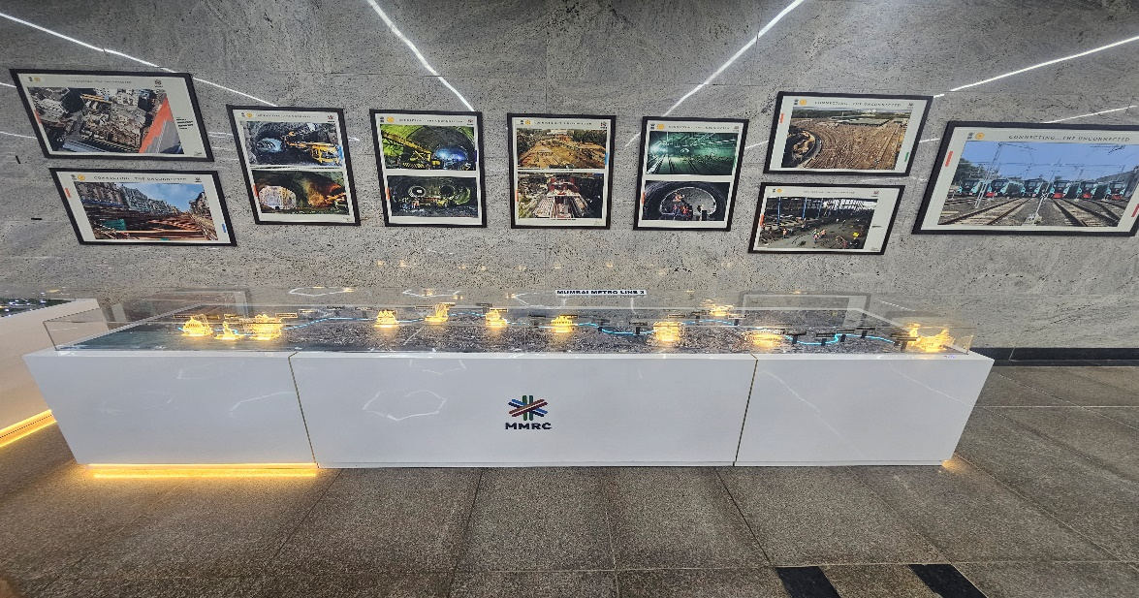
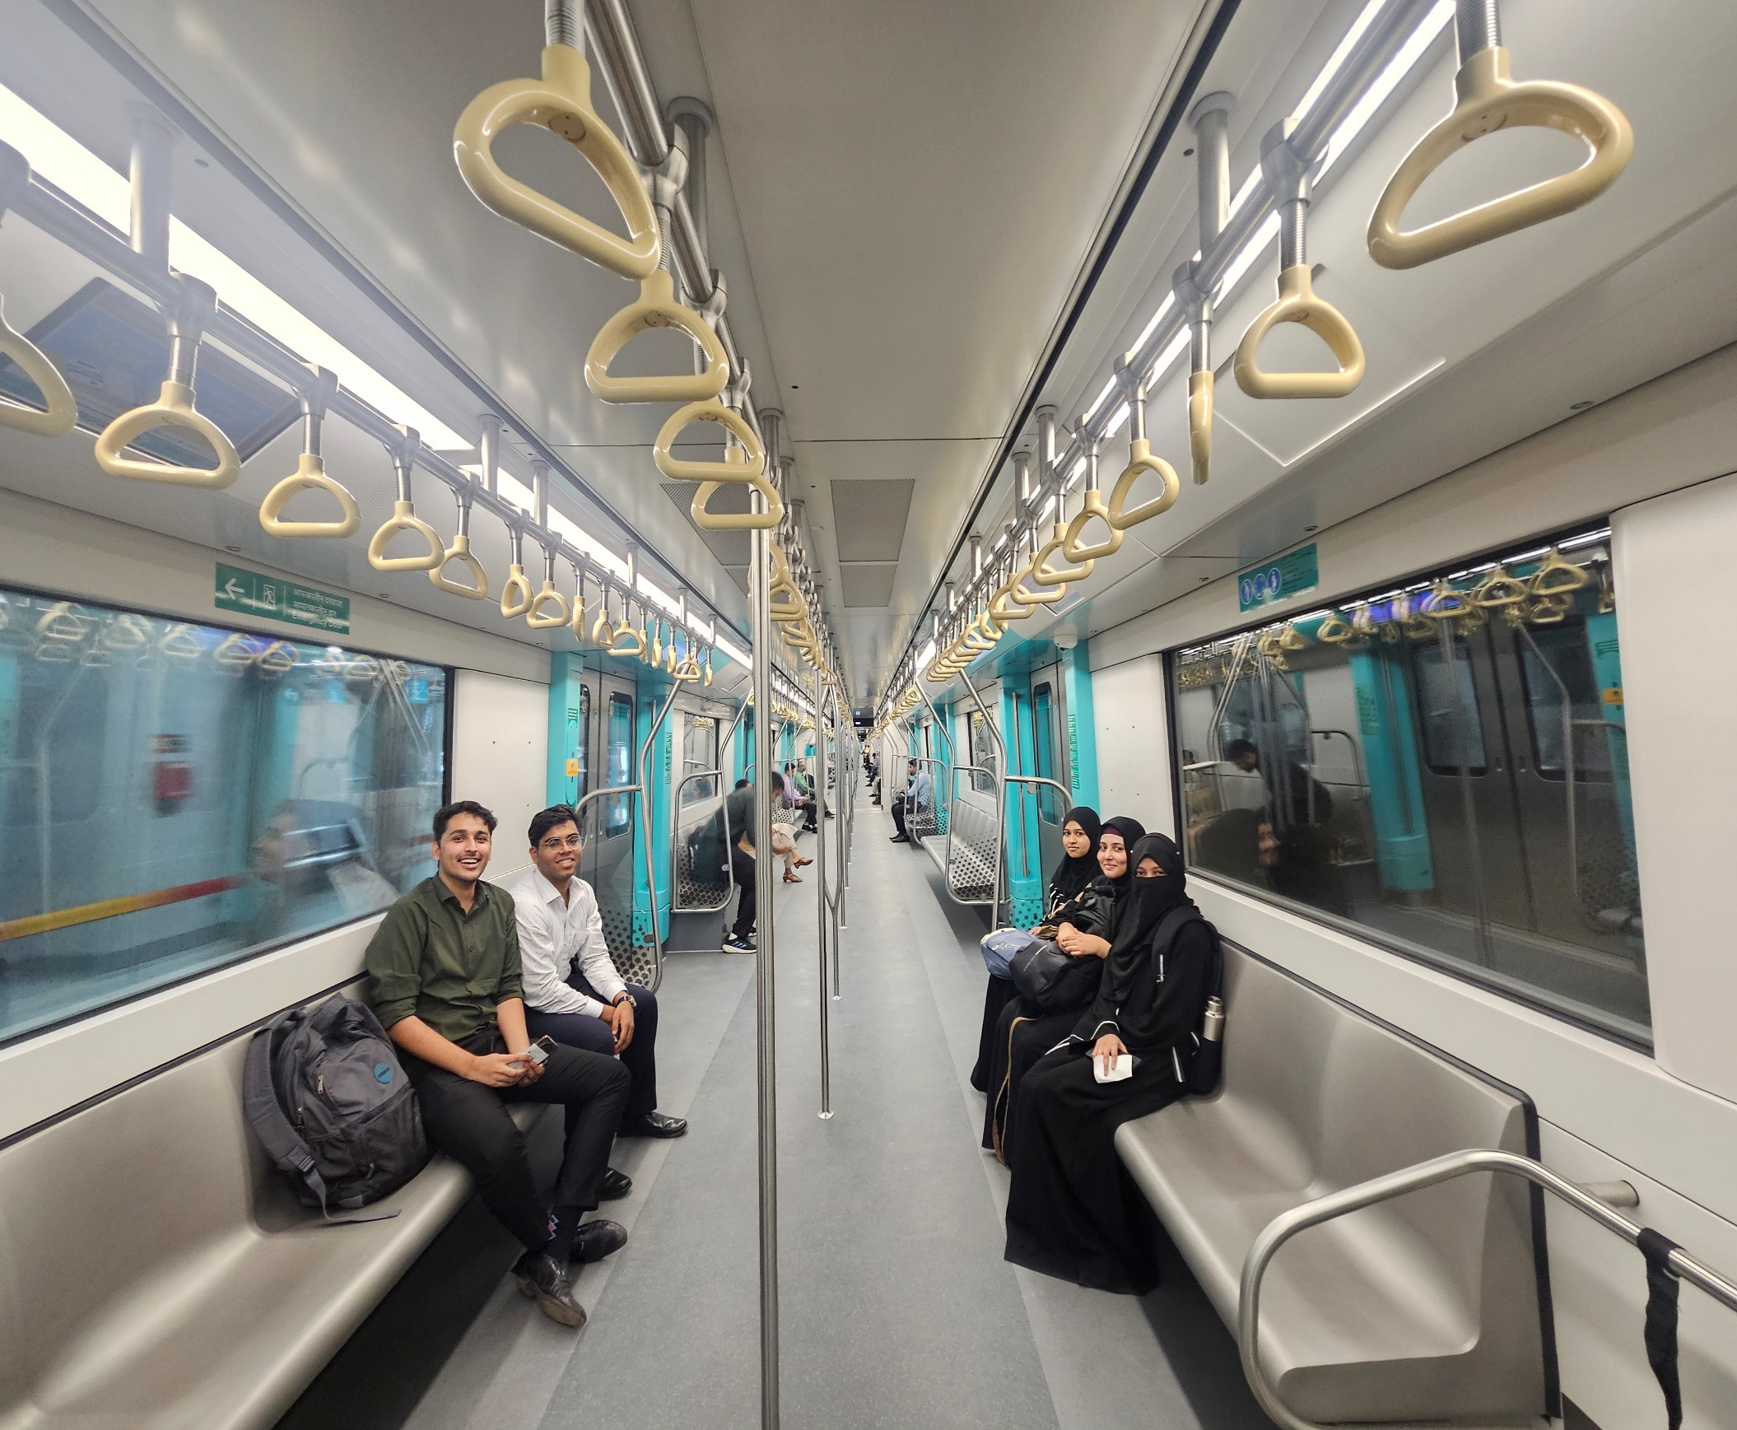
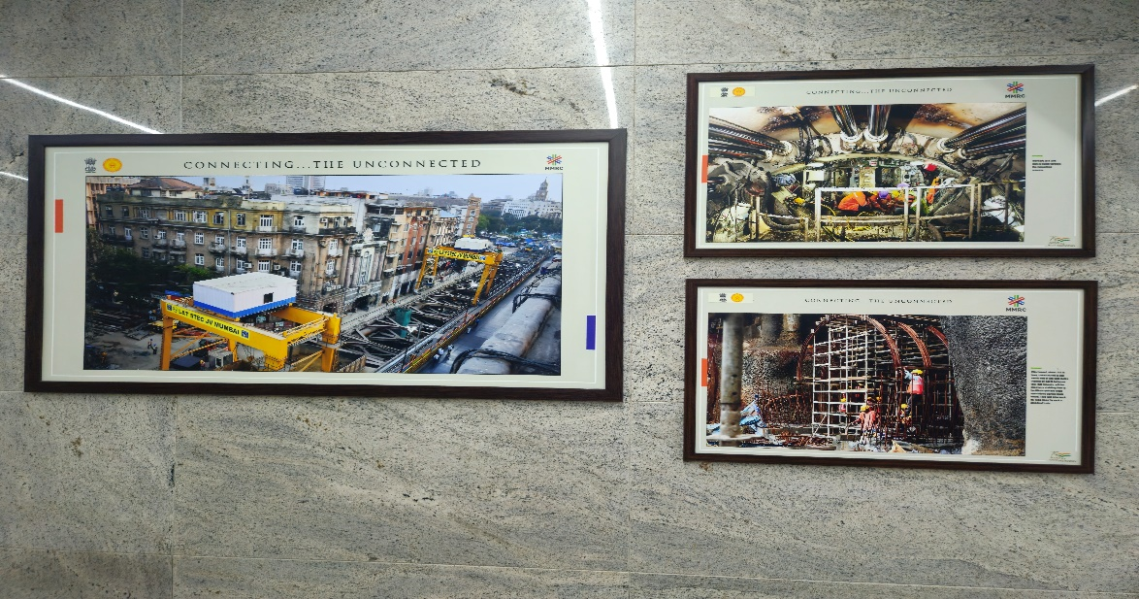
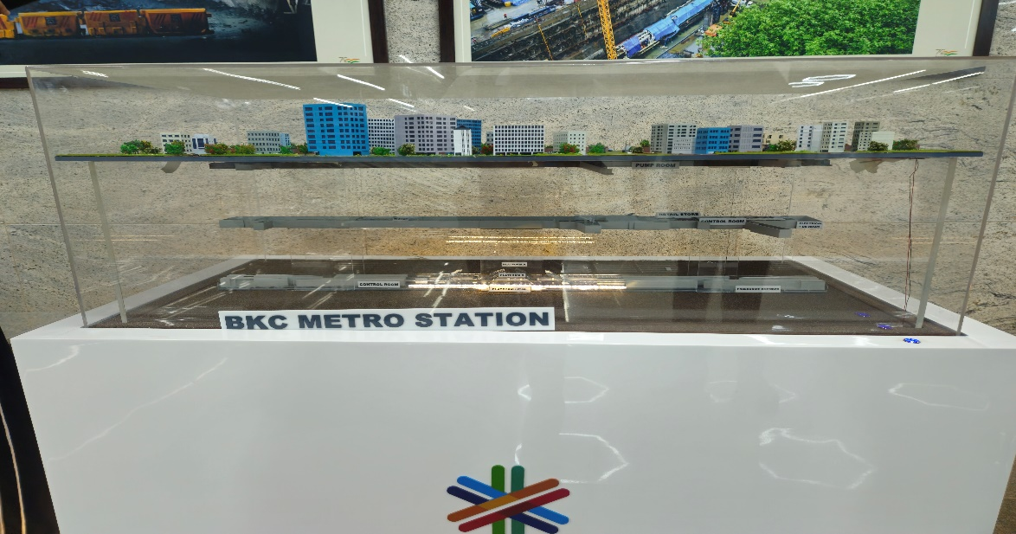
Field Visit

Slide 19
References
https://news.abplive.com/cities/mumbai-news-fire-breaks-out-at-bkc-metro-station-services-briefly-disrupted-caught-on-camera-video-1731470
https://www.republicworld.com/india/mumbai-s-first-underground-metro-line-3-services-delayed-due-to-technical-glitch-passengers-react
https://ganttpro.com/gantt-chart-template/
https://www.business-standard.com/india-news/mumbai-metro-3-launch-stations-timings-fares-of-city-s-underground-line-124100900404_1.html
https://www.blackmagicdesign.com/in/products/davinciresolve/

Slide 20
Thank You!

